Slide 1
Counting and recognizing non-moving objects by means of image processing
ESAT 1A1
Co-titular: Tinne Tuytelaars
Coaches: Xuanli Chen & José Oramas
Realised by: Max Beerten, Brent De Bleser, Wouter Devos,
Ben Fidlers, Simon Gulix, Tom Kerkhofs

Slide 2
Table of contents
Introduction
Problem description
Hardware
Software
Depth
Overlap
Colour
Application
Flaws
GUI
Conclusion

Slide 3
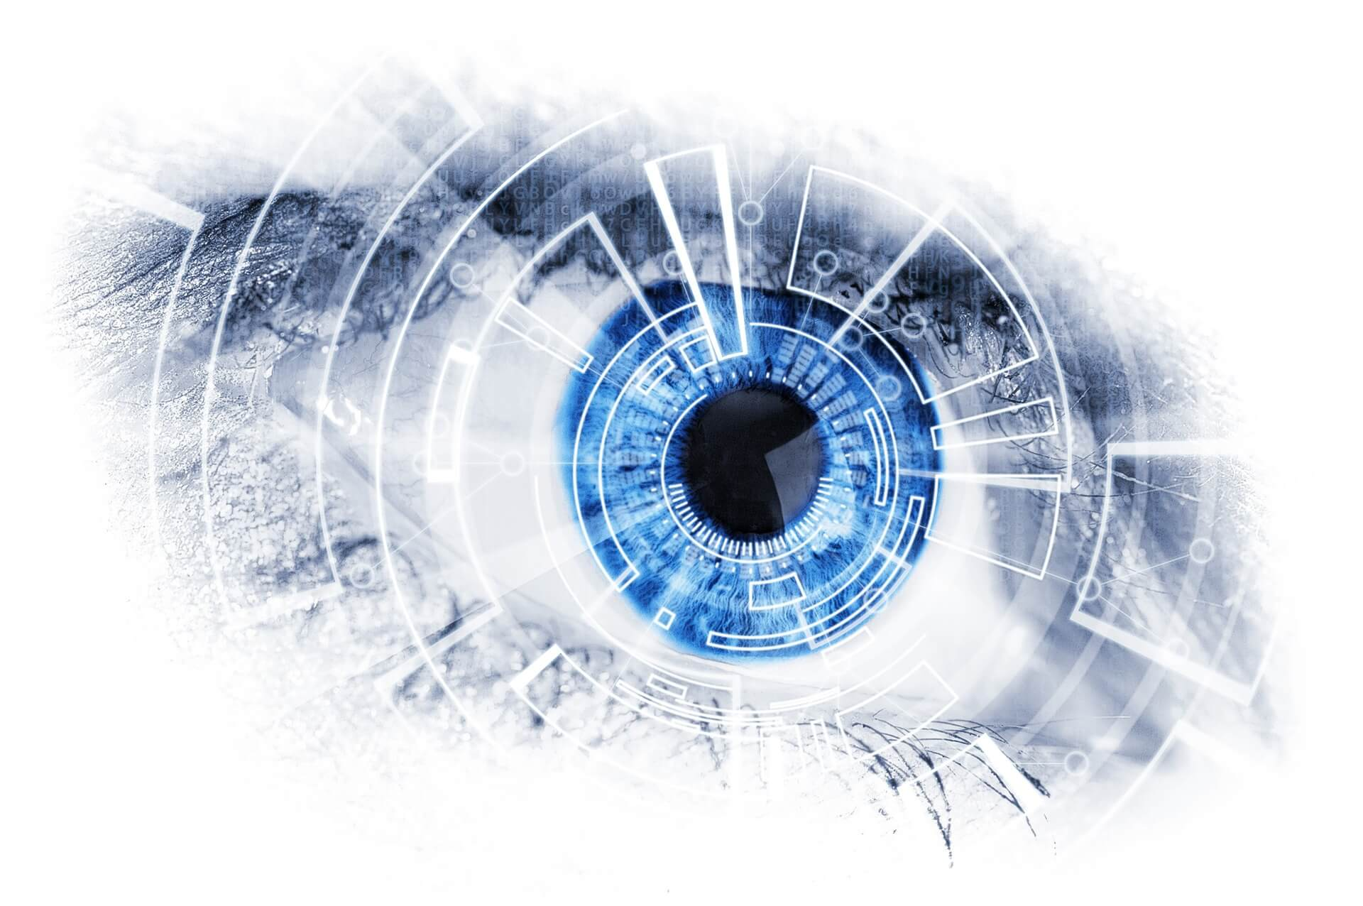
1. Introduction
Object counting using image processing
AI and machine learning
PSI at ESAT
Retrieved from DevisionX ¹
¹ Why you should integrate machine vision in your production process? (02/02/18). Retrieved (22/11/2018), from https://devisionx.com

Slide 4
Table of contents
Introduction
Problem description
Hardware
Software
Depth
Overlap
Colour
Application
Flaws
GUI
Conclusion

Slide 5
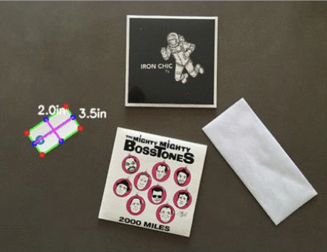
2. Problem description
Visual inspection system
Objects of uniform colour and shape
Camera
Retrieved from Toledo ²
² Opgaveblad P&0 3: Automatisch tellen van voorwerpen in een beeld

Slide 6
Table of contents
Introduction
Problem description
Hardware
Software
Depth
Overlap
Colour
Application
Flaws
GUI
Conclusion

Slide 7
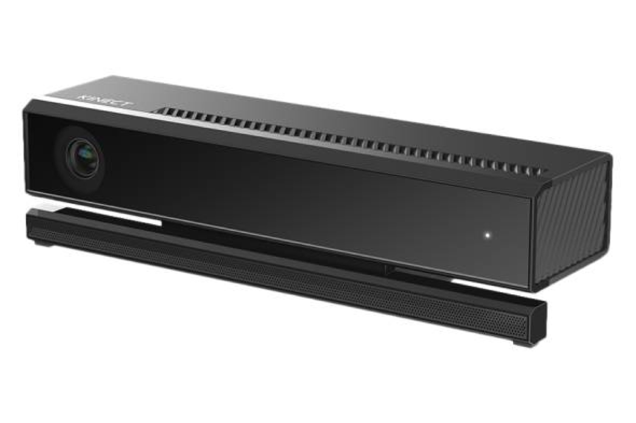
3. Hardware
Hardware components:
Camera
Transfer cable
PC
Box
Retrieved from Time ³
FOTO BOX
³ Why you should integrate machine vision in your production process? (07/07/14). Retrieved (14/12/2018), from http://time.com/2962269/kinect-v2-0-for-windows/

Slide 8
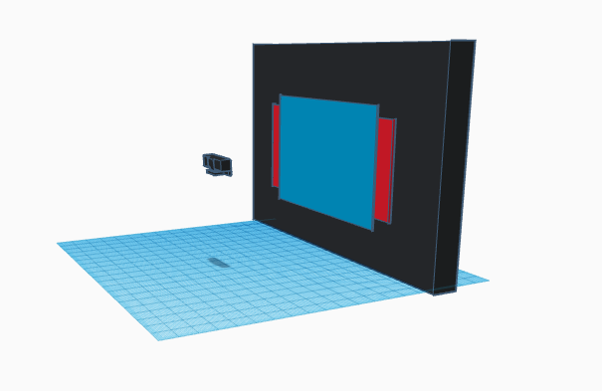
3. Hardware
Kinect v2
Colour and depth sensor
Different field of views
Matrix representation

Slide 9
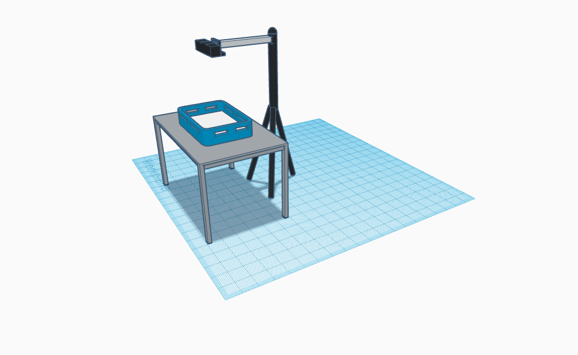
3. Hardware
Visual setup:
Height
Angle
Lighting

Slide 10
Table of contents
Introduction
Problem description
Hardware
Software
Depth
Overlap
Colour
Application
Flaws
GUI
Conclusion

Slide 11
4. Software

Slide 12
Table of contents
Introduction
Problem description
Hardware
Software
Depth
Overlap
Colour
Application
Flaws
GUI
Conclusion

Slide 13
3.a Depth

Slide 14
Table of contents
Introduction
Problem description
Hardware
Software
Depth
Overlap
Colour
Application
Flaws
GUI
Conclusion

Slide 15
3.b Overlap

Slide 16
Table of contents
Introduction
Problem description
Hardware
Software
Depth
Overlap
Colour
Application
Flaws
GUI
Conclusion

Slide 17
3.c Colour

Slide 18
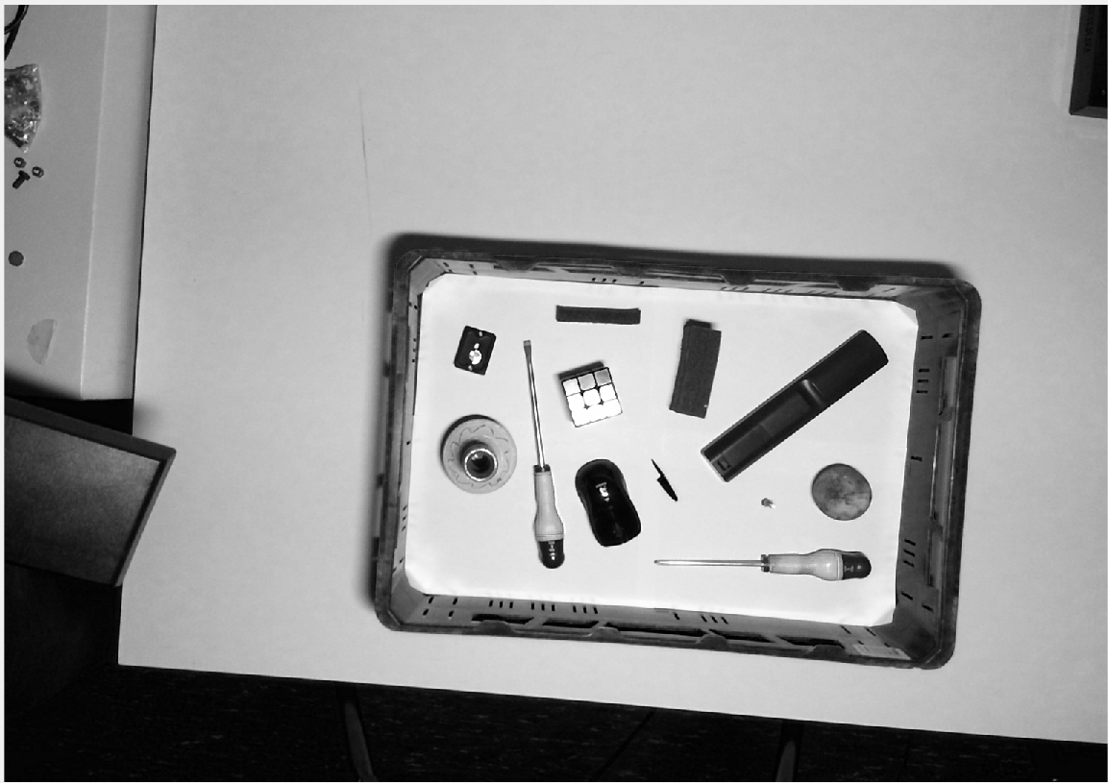
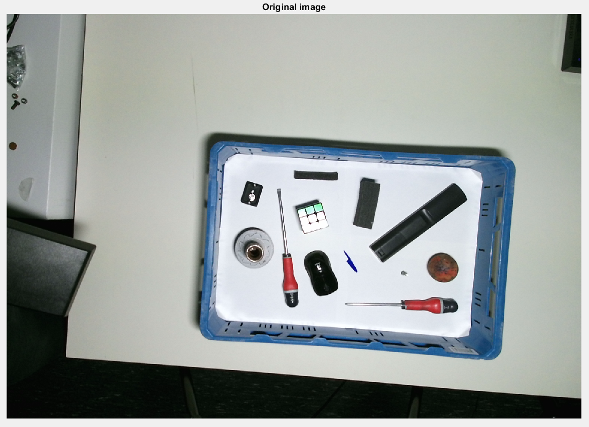
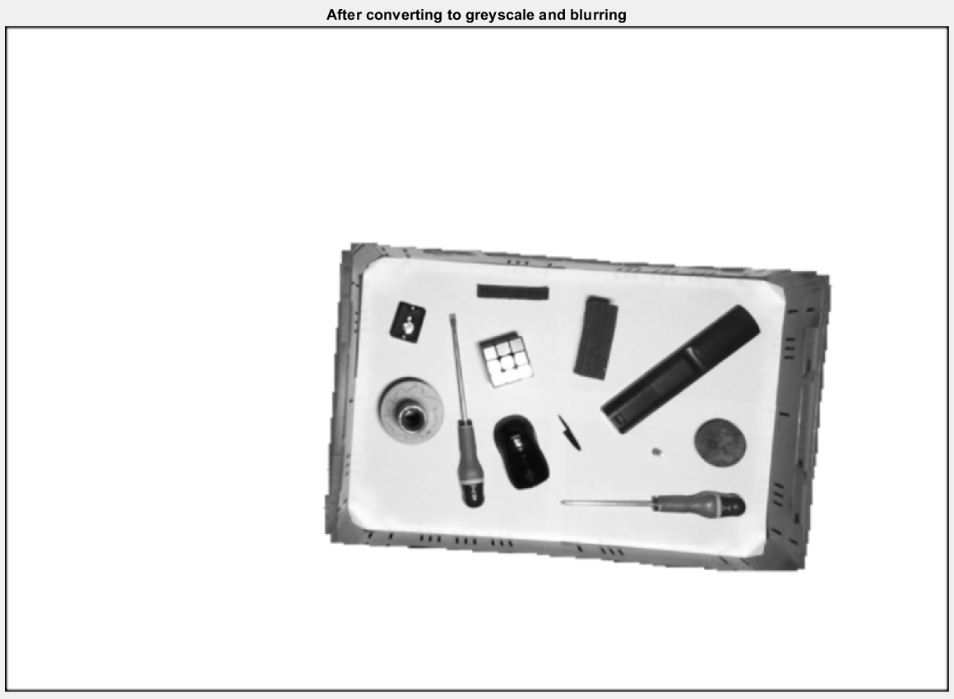
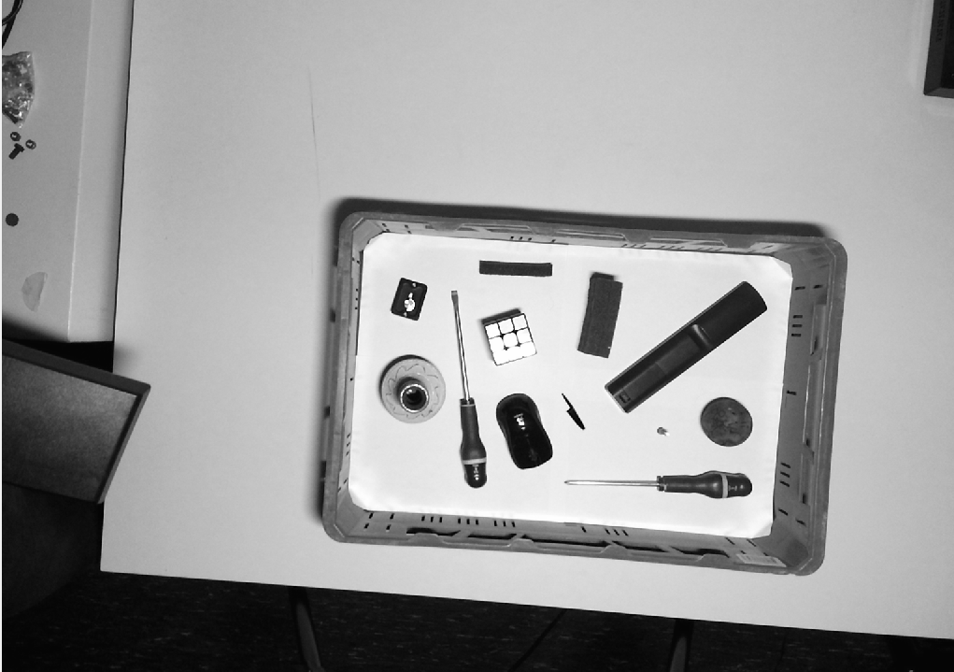
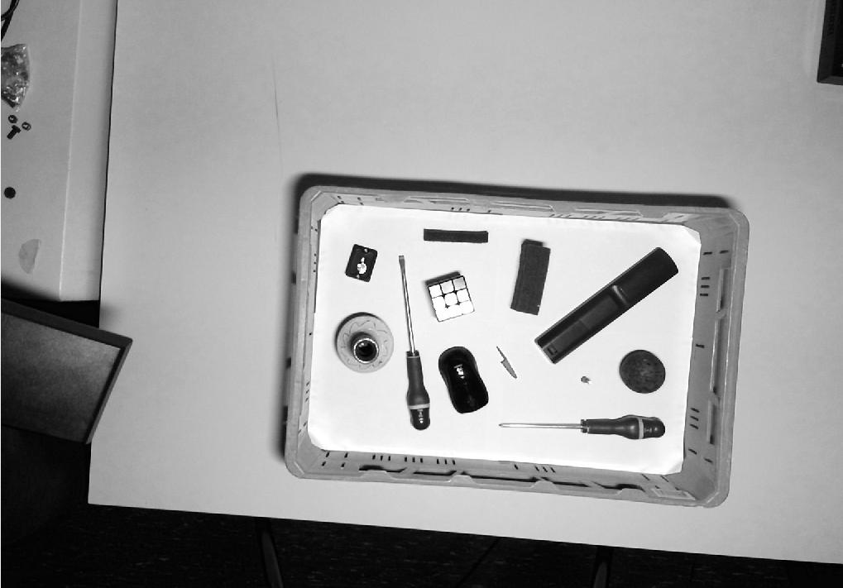
Step 1: Converting to greyscale
Red
0.2989
Green
0.5870
0.1140
Blue

Slide 19
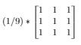
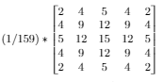
Step 2: Blurring
First a mean blur, than a gaussian blur.
Mean kernel
Gaussian kernel
*
*

Slide 20
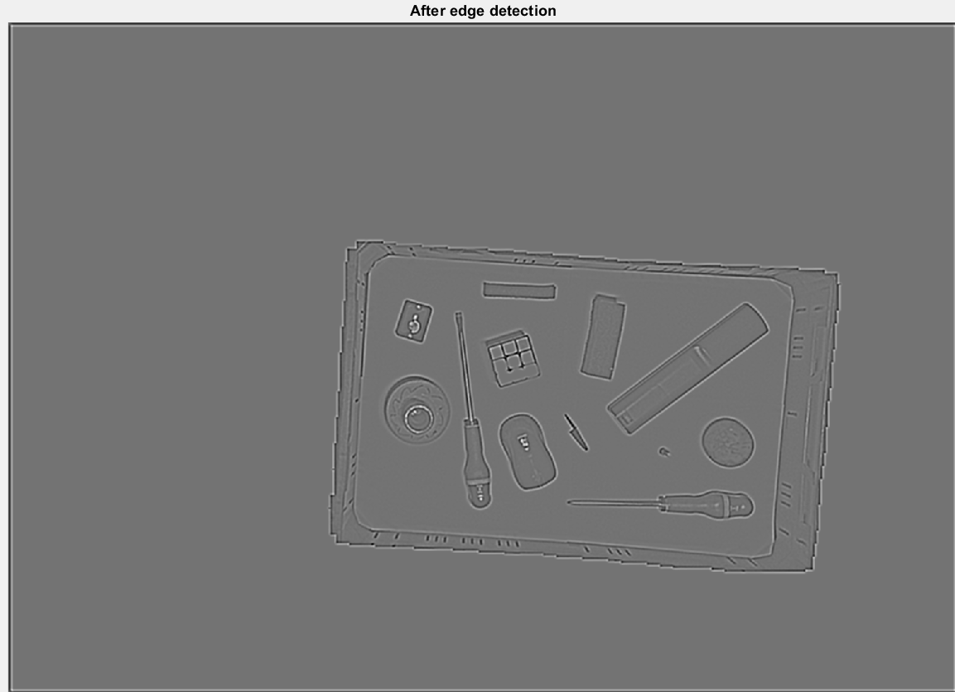
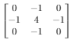
Step 3: Edge detection
*
=

Slide 21
Problem with convolutions
0
0
0
0
0
0
0
0
0
0
00000000000000
Remove_boundary()

Slide 22
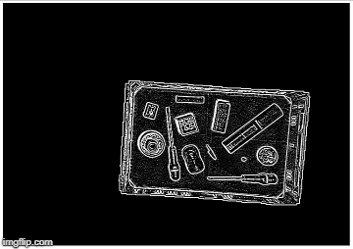
Step 4: Thresholding edge
Notice the white border

Slide 23

Step 5: Grouping

Slide 24
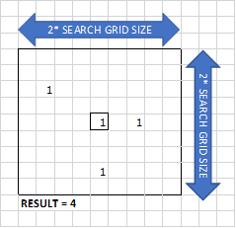
Loop through every pixel:
Check if pixel is black
Count same pixels values in grid
Check if that amount of pixels is big enough
Search for group number in grid (No group found? -> assign new group number)
Place group number in matrix

Slide 25
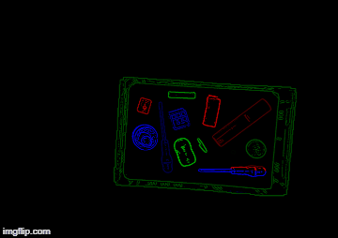
Step 6: Regrouping
Loop through every pixel (right-top to left-bottom)
Check if group number is not 0.
Check if there is another group in the X-pixels below this pixel.
Replace group number of the bottom group with the top group number.

Slide 26
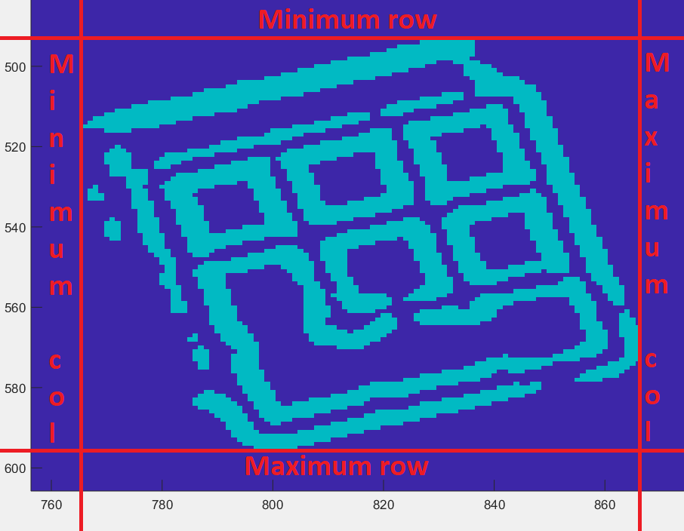
Step 7: Drawing boundary boxes

Slide 27
Table of contents
Introduction
Problem description
Hardware
Software
Depth
Overlap
Colour
Application
Flaws
GUI
Conclusion

Slide 28
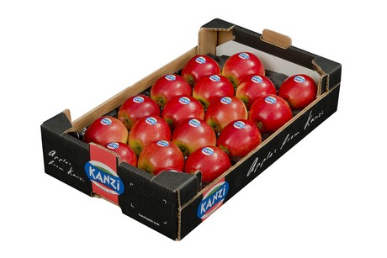
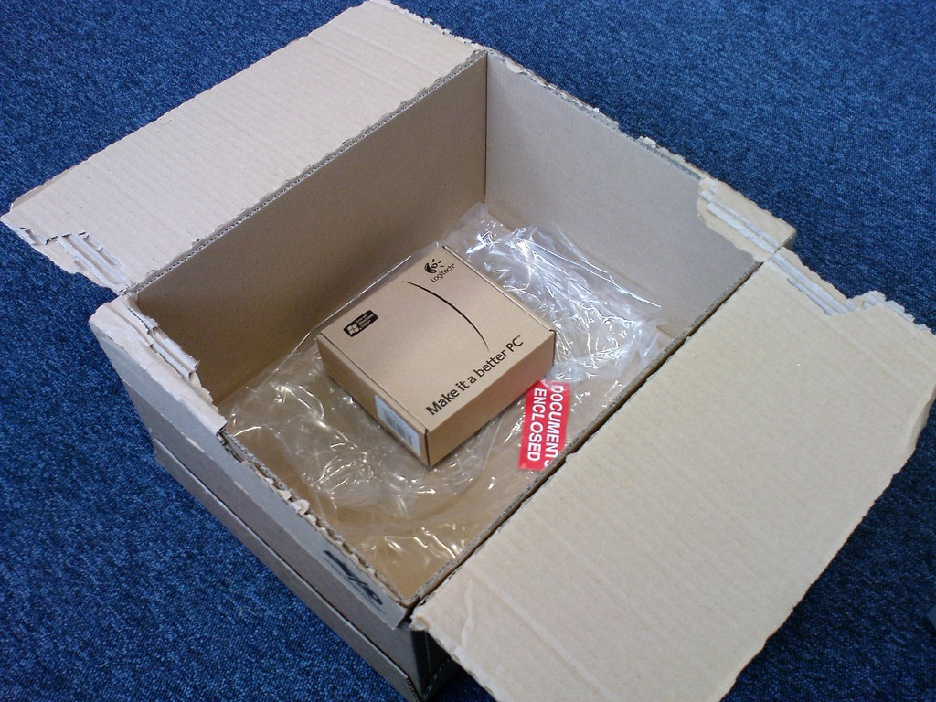
5. Application
General:
Engineering project
Counting uniform objects
Optimal object packaging
Retrieved from Freshplaza ⁴
Solving the Box Selection Algorithm
Retrieved from Medium ⁵
⁴ Preis für Kanzi erzielt Rekordhöhe (06/03/18). Retrieved (15/12/2018), from https://www.freshplaza.de/artikel/5015819/preis-fuer-kanzi-erzielt-rekordhoehe/
⁵ Solving the Box Selection Algorithm (01/07/16). Retrieved (14/12/2018), from https://medium.com/the-chain/solving-the-box-selection-algorithm-8695df087a4

Slide 29
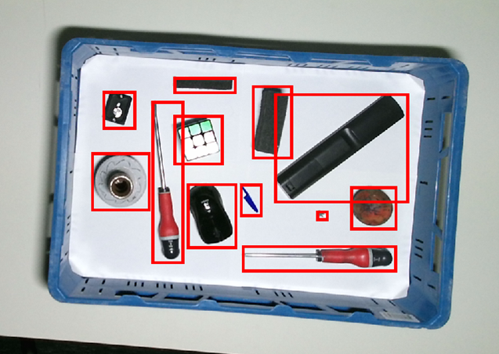
5. Application
Approach
Starting where we left off
Cut objects out of image
Sort them from large to big
Fill the given basket as efficient as possible

Slide 30
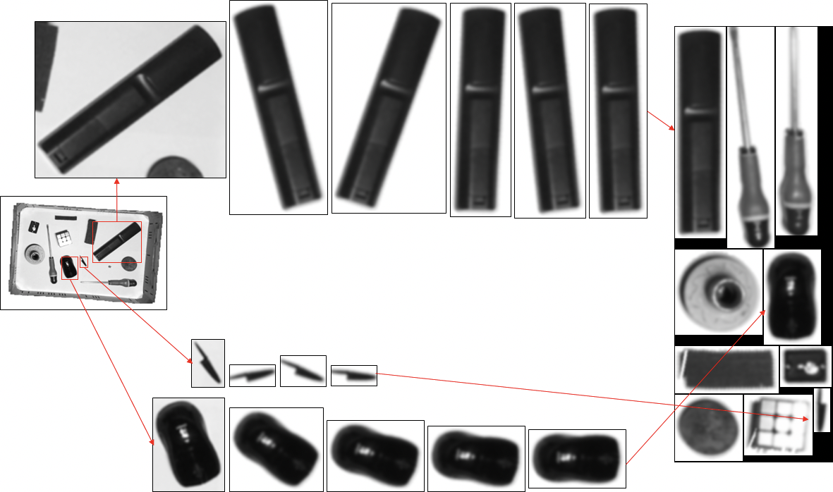
5. Application
Step 1:
Gathering all objects
Non-optimal packaging
Elements get whitened (in deze stap al??)

Slide 31
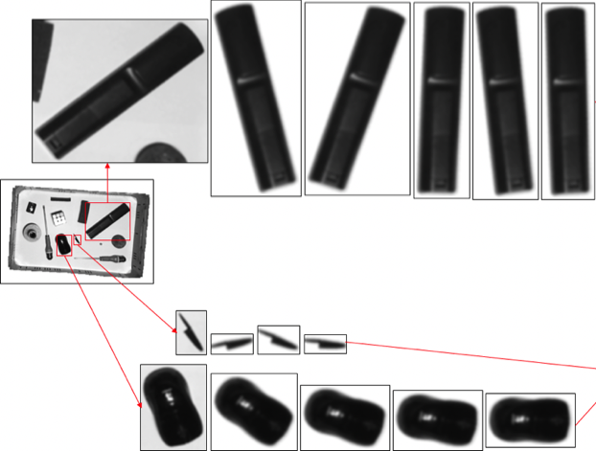
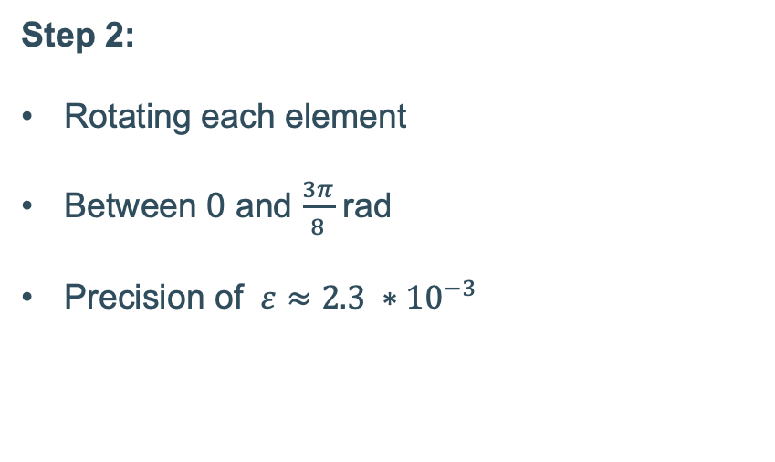
5. Application
Step 2:
Rotating each element
Between 0 and $\frac{3π}{8}$ rad
Precision of $ε≈2.3 ∗{10}^{−3}$

Slide 32
5. Application
Step 3:
Combining all optimal boundary boxes
Greedy algorithm
Normal matrix and its transpose

Slide 33
Table of contents
Introduction
Problem description
Hardware
Software
Depth
Overlap
Colour
Application
Flaws
GUI
Conclusion

Slide 34
6. Flaws

Slide 35
Table of contents
Introduction
Problem description
Hardware
Software
Depth
Overlap
Colour
Application
Flaws
GUI
Conclusion

Slide 36
7. GUI

Slide 37
Table of contents
Introduction
Problem description
Hardware
Software
Depth
Overlap
Colour
Application
Flaws
GUI
Conclusion

Slide 38
8. Conclusion

